Slide 1
Utility of Dynamic Bayesian Networks based Data generators
Highlighting problems that DBN-based data generator would solve

Slide 2
Current Setup and its Challenges
Highlighting the problems that DBN-based data generator can solve

Slide 3




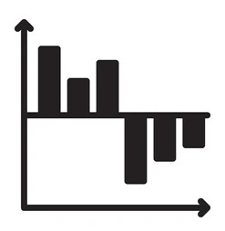

Current Setup for Validation
Dataset
Data Dictionary
Forecasts
Data-based validation
Codebase to perform:
Feature engineering
Modelling
Feature Contributions
Business/Human Validation

Slide 4
Current Setup for Validation (Contd.)
We have a dataset, along with the data dictionary, from client.
We try to see if the contributions from the features make business sense or not.
The features often include complex engineered features whose contributions are hard to ascertain.
For example, trend and seasonality, base-price, promotional discount etc. are derived out of complex calculations on the sales quantity.

Slide 5
Scenario I – Incorrect notions about feature impacts
The standard regression/forecasting setup is applied. The feature impacts are read-off from the contributions reported by the model.
Promotional discounts give a positive contribution to sales which makes business sense.
Business proceeds with increasing the discount percentage. But it does not increase the sales.
Are we sure that the contributions reported against discounts were truly reflecting its real-world impact? In what setup are they reliable, and where are they not?

Slide 6
Scenario II – Not enough scope for testing
A modelling setup is finalized based on its test set performance. This is a robust strategy for non-timeseries scenarios.
For timeseries scenarios the idea is that with the passage of time, a retraining with new data would be triggered and forecasts generated. The original test set performance would indicate the accuracy of such forecasts.
However, a model monitoring setup should keep recording the forecast performances for multiple cycles, over a certain amount of time. Only then the true efficacy of the modelling strategy can be estimated.

Slide 7
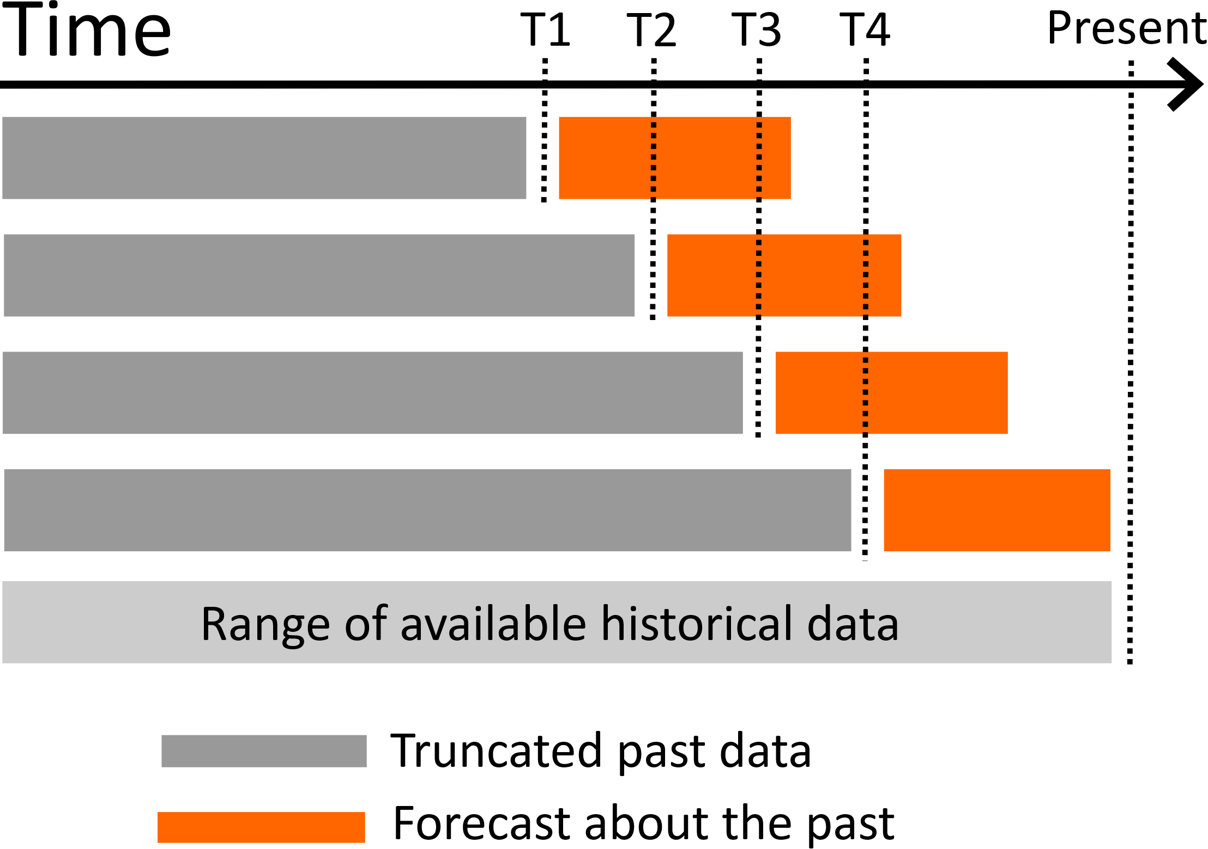
Ideal test setting for time-series data
Greyed out span actually accommodates training + validation (for tuning) sets.
Span of historical data should be large.

Slide 8
Scenario II – Not enough scope for testing (contd.)
Thus, a forecasting setup inherently requires a long time to gain confidence.
The other option is simulating multiple cycles of retraining-forecasting-validating with the training data itself. Seldom such amounts of data are available that would allow for this, after accounting for the necessary amount of training and test sets.

Slide 9
Scenario III – Testing generizability of solution strategies across industry
There are standard practices prevalent across projects for a CPG industry. For example,
methods to calculate base-price and promotional discounts
using seasonality and trend components across different hierarchical levels as features for non-timeseries algorithms like ElasticNet etc.
modelling at UPC x POS (point-of-sales) level for CPG industries
These strategies are used for any project from CPG industry.
After being tested in 3 projects it fails for the 4th one.

Slide 10
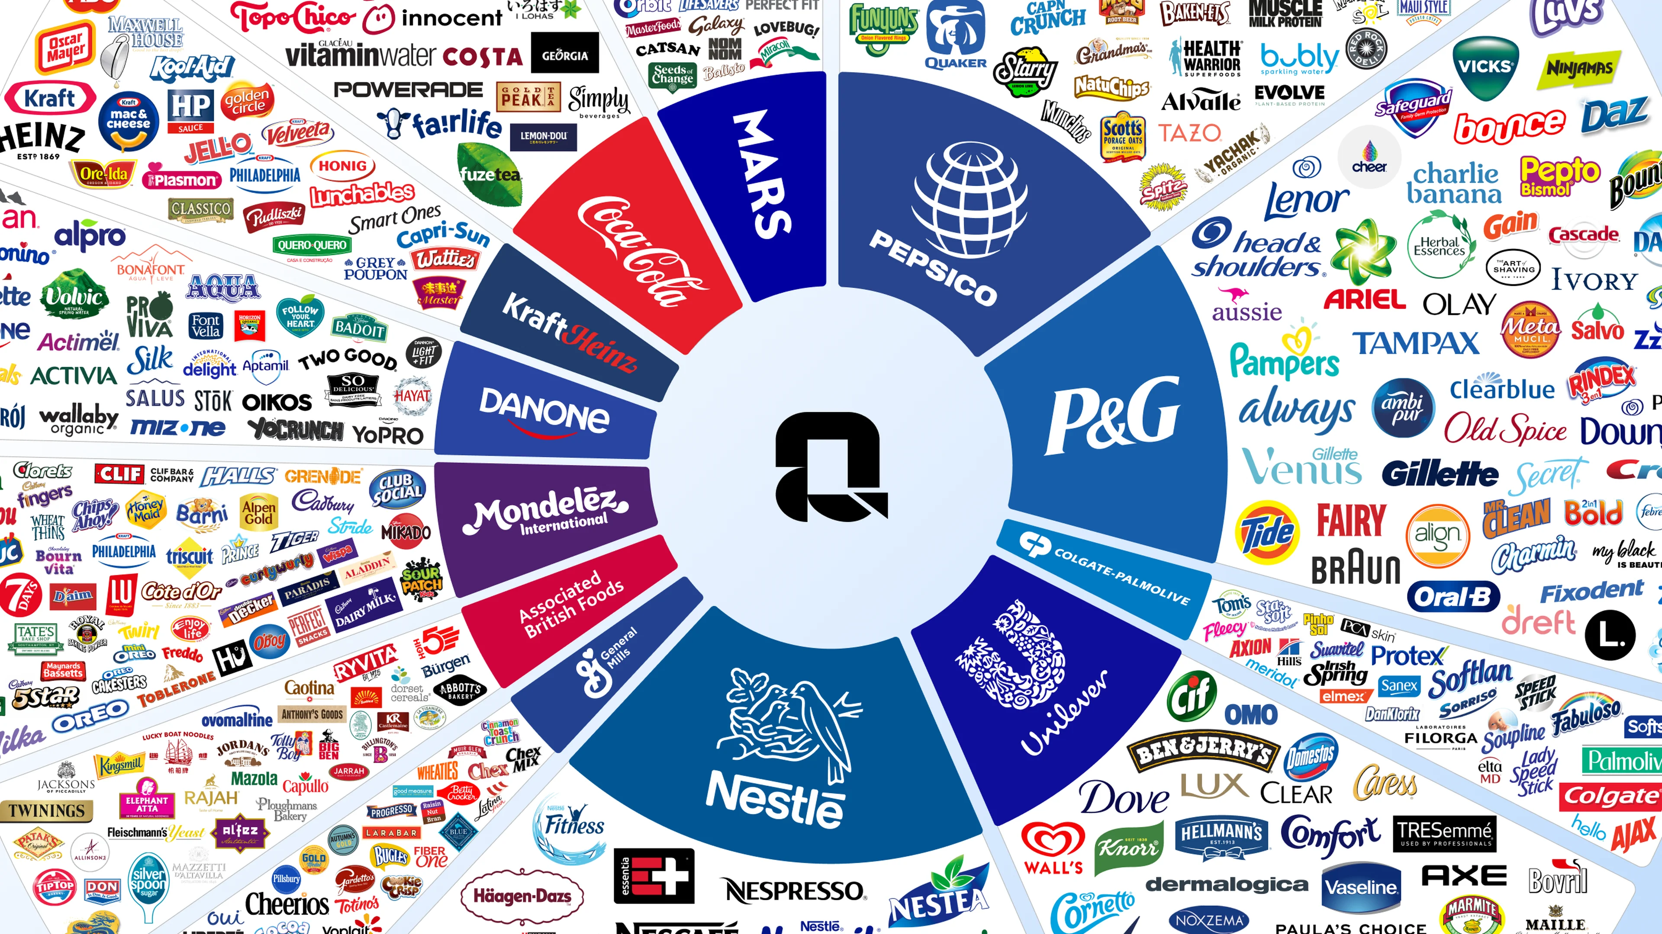
Scenario III – Testing generizability of solution strategies across industry (contd.)
To test the generalizability of these approaches across the CPG industry, first we should have the opportunity to work with the wide variety of clients across the industry.
Rarely a firm would gain access data from such a large clientele.

Slide 11
How to think of DBN Data Generator
A broad perspective to understand its applications

Slide 12
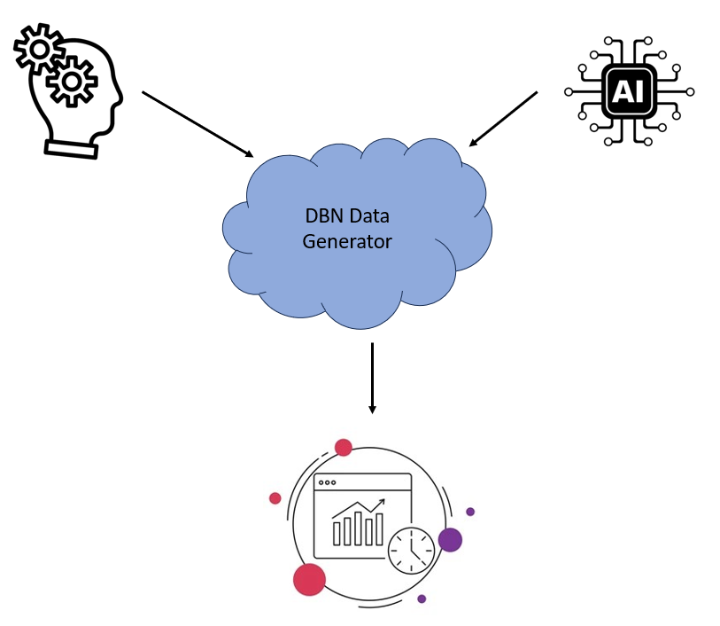
DBN Data Generator – Proxy for Real World
DBN Data Generator is a data generating mechanism where one can explicitly specify the details of the data generating mechanism. Out of it multivariate time-series/non-timeseries data would be generated.
The specifications can be from human end or AI-generated.
The main difference of this from other available synthetic data generators, is its capability to incorporate time dependence in the data generating mechanism, just like the way it happens in real world.

Slide 13



$$T_{0}$$
$$T_{1}$$
$$T_{2}$$
Discount
Discount
Discount
Week
Week
Week
Sales
Sales
Sales
Base Price
Base Price
Base Price
Year
Year
Year

Slide 14
Data Generating Process
The values for the variables are generated one time-step at a time.
The network structure is used to specify the dependency amongst the variables. This includes the temporal dependencies as well; sales at any time-step depends on discounts from the earlier time-step, and on sales from the 2 earlier time-steps.
The exact data generating formula against the nodes and the arrows provide full control over the data generating process.

Slide 15
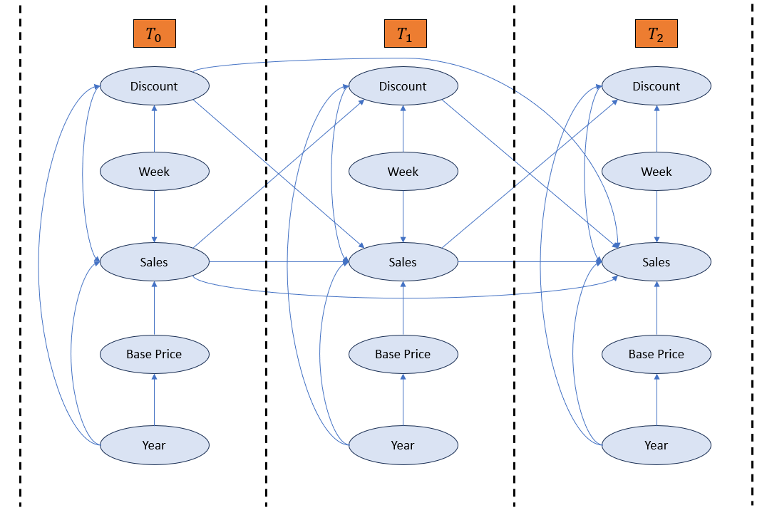
Data Generation Process (contd.)
The temporal dependencies are incorporated naturally in the data generation process. That is, as it happens in real world.
It is flexible so it can be adjusted to replicate any real-world scenario.

Slide 16
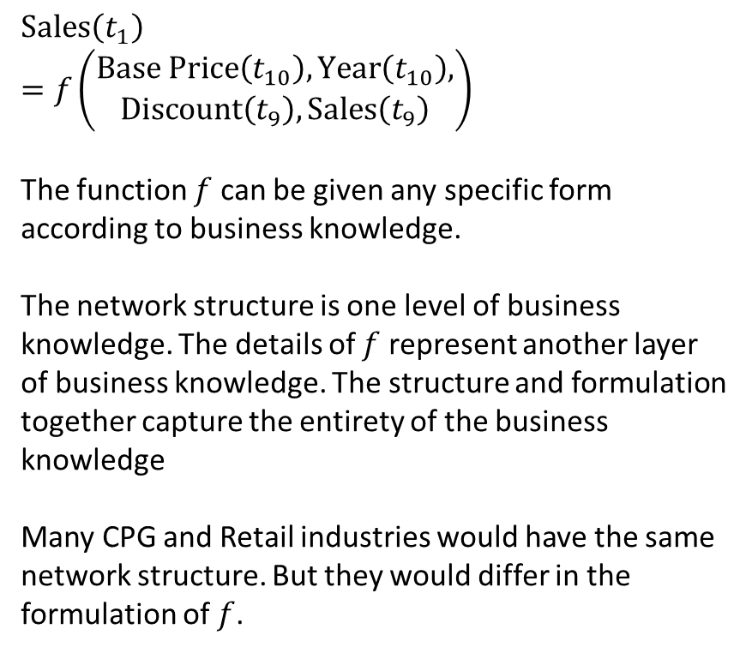
Sample Data Generation for a Node
$$\text{Sales}\left(t_{1}\right) \\ =f\left(\begin{aligned}\text{Base} \text{Price}\left(t_{10}\right), \text{Year}\left(t_{10}\right), \\ \text{Discount}\left(t_{9}\right), \text{Sales}\left(t_{9}\right)\end{aligned}\right)$$
The function $f$ can be given any specific form according to business knowledge.
The network structure is one level of business knowledge. The details of $f$ represent another layer of business knowledge. The structure and formulation together capture the entirety of the business knowledge
Many CPG and Retail industries would have the same network structure. But they would differ in the formulation of $f$.
Year
Sales
Sales
Discount (%)
Base Price

Slide 17
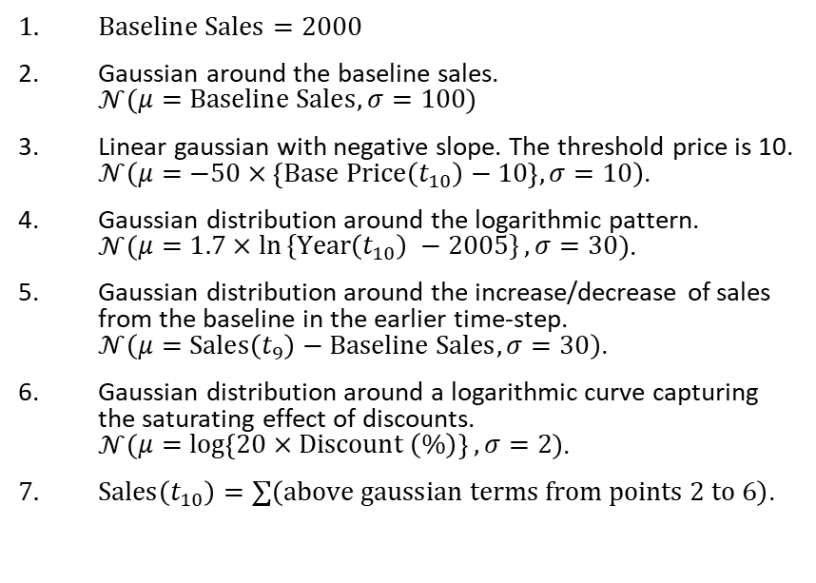
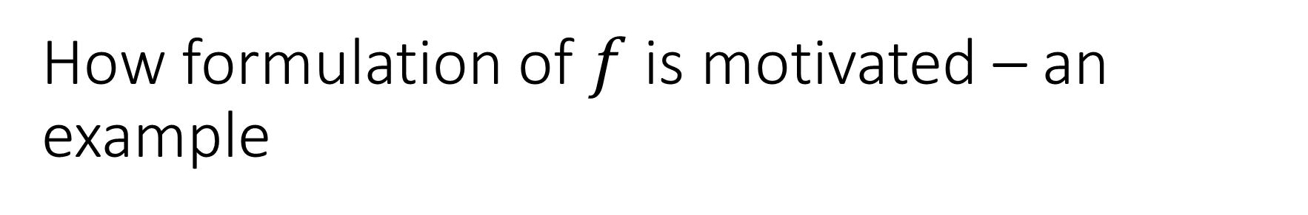
How formulation of $f$ is motivated – an example
Business Motivation
Mathematical Formulation
There is always a baseline sales specific to the business.
The “intrinsic” sales hovers around the baseline. Intrinsic meaning sales that happen without any intervention.
The base-price (or pre-discount price) of the item governs the sales. If it goes beyond a threshold, it decreases the sales. The more it lies below the threshold the more the sales.
The YoY (year-on-year) sales of the product, since its launch in 2005, follows a logarithmic pattern.
There is a lag effect of sales from the earlier time-step. The idea is that the sales in the earlier step is above or below the baseline by a certain amount. There would be a tendency in the current time-step sales to follow that same direction.
The higher the discount levels, the greater the sales up to a certain limit. After that discounts tend to have little impact.
Sales at current time-step are a linear combination of all these effects.
$\text{Baseline} \text{Sales}=2000$
Gaussian around the baseline sales. $𝒩\left(\begin{aligned}μ=\text{Baseline} \text{Sales},σ=100\end{aligned}\right)$
Linear gaussian with negative slope. The threshold price is 10. $𝒩\left(\begin{aligned}μ=−50×\left\{\text{Base} \text{Price}\left(t_{10}\right)−10\right\},σ=10\end{aligned}\right)$.
Gaussian distribution around the logarithmic pattern. $𝒩\left(\begin{aligned}μ=1.7×\ln{\text{\{}\text{Year}\left(t_{10}\right) −2005\}},σ=30\end{aligned}\right)$.
Gaussian distribution around the increase/decrease of sales from the baseline in the earlier time-step. $𝒩\left(\begin{aligned}μ=\text{Sales}\left(t_{9}\right)−\text{Baseline} \text{Sales},σ=30\end{aligned}\right)$.
Gaussian distribution around a logarithmic curve capturing the saturating effect of discounts. $𝒩\left(\begin{aligned}μ=\log\left\{20×\text{Discount} \left(\%\right)\right\},σ=2\end{aligned}\right)$.
$\text{Sales}\left(t_{10}\right)=∑\left(\text{above} \text{gaussian} \text{terms} \text{from} \text{points}\text{ 2 }\text{to}\text{ 6}\right)$.

Slide 18
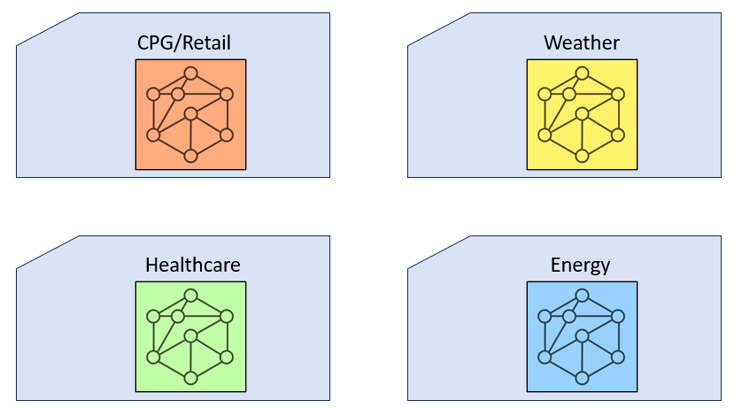
Data generating templates for different industries
A network structure involving the variables for the respective industry, and the detailed formulations in it, together form the data generation template for a specific industry.
These templates can be used to quickly simulate data for the respective industry. The templates can also be further customised as needed.
The knowledge to create these templates can be gathered from SMEs (subject matter experts) or LLMs.

Slide 19

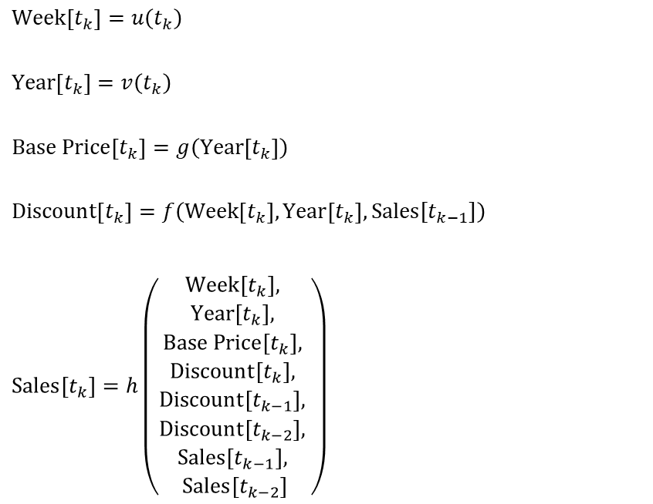
An easy representation of data generating process
Representation of network structure
Representation of formulations
$$\text{Week}\left[t_{k}\right]=u\left(t_{k}\right)$$
$$\text{Year}\left[t_{k}\right]=v\left(t_{k}\right)$$
$$\text{Base} \text{Price}\left[t_{k}\right]=g\left(\text{Year}\left[t_{k}\right]\right)$$
$$\text{Discount}\left[t_{k}\right]=f\left(\text{Week}\left[t_{k}\right], \text{Year}\left[t_{k}\right], \text{Sales}[t_{k−1}]\right)$$
$$\text{Sales}\left[t_{k}\right]=h\left(\begin{aligned}\text{Week}\left[t_{k}\right], \\ \text{Year}\left[t_{k}\right], \\ \text{Base} \text{Price}\left[t_{k}\right], \\ \text{Discount}\left[t_{k}\right], \\ \text{Discount}\left[t_{k−1}\right], \\ \text{Discount}\left[t_{k−2}\right], \\ \text{Sales}\left[t_{k−1}\right], \\ \text{Sales}\left[t_{k−2}\right]\end{aligned}\right)$$
$u\left(t_{k}\right)=\text{get}\text{_}\text{week}\text{_}\text{number}\left(t_{k}\right), \text{where} \text{get}\text{_}\text{week}\text{_}\text{number} \text{is} \text{a} \text{function} \text{that} \text{gets} \text{the} \text{week} \text{from} t_{k}$.
Similar for $v\left(t_{k}\right)$.
$$g\left(\text{Year}\left[t_{k}\right]\right)=$$

Slide 20
How DBN solves the problems
Details of the DBN setup that helps address each of the problems

Slide 21
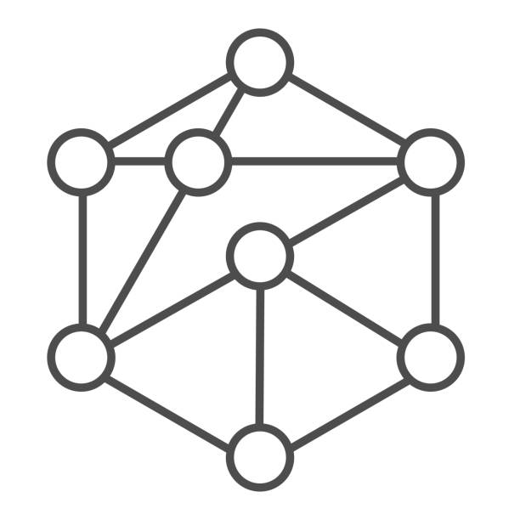
Setup with DBN based Data Generator
DBN based Data Generator
Forecasts
Future Data
Dataset
Codebase to perform:
Feature engineering
Modelling
Feature Contributions

Slide 22
Setup with DBN based Data Generator (Contd.)
The DBN Generator generates the data according to a given setting.
It allows continuous generation of unlimited data which is used for both training and testing.
A compete knowledge of the data generating mechanism allows calculation of original impact of interventions (like change in price or discount), which is tallied against those from model output.

Slide 24
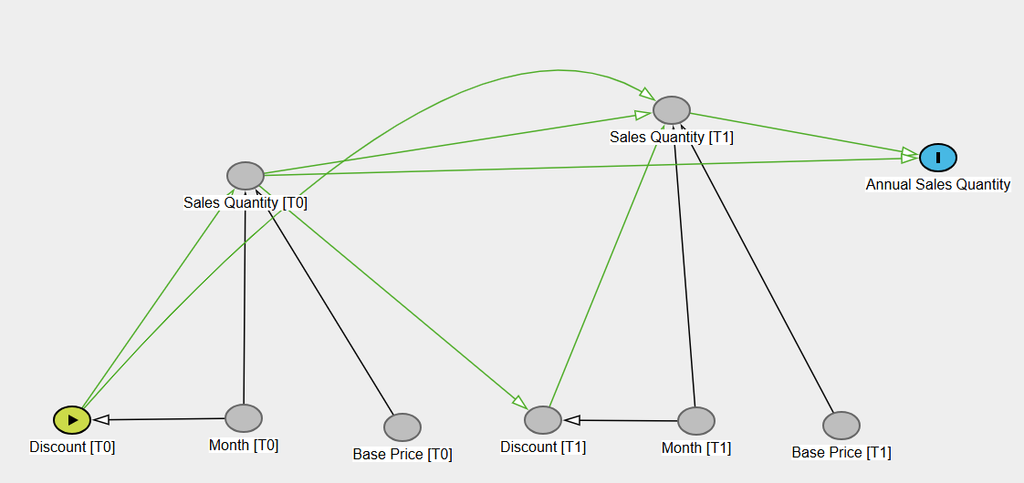
Example – Identifying original contributions
For example, impact of a discount calendar, towards the annual sales, can be identified in real time.
The contributions derived from the modelling approaches, can be compared against these “original” impact.

Slide 25
Example – Identifying original contributions (contd.)
The purpose of knowing contributions is to gain actionable insights. Based on the contribution of discount, a certain discount strategy is implemented expecting that the respective revenue change would be observed over time.
Hence it’s important to compare contributions from the model output against such causal impacts observed in the data generating mechanism.

